Slide 1

Capstone Project – 4
Machine Learning – Unsupervised
Team Champions : Online Retail Customer Segmentation
Team Members
Varsha Rani
Vivek Chandrakant Pawar
Rabista Parween
Tushar Gaikwad

Slide 2
POINTS FOR DISCUSSION
Problem Description
Data Summary
Importing Libraries & Data Inspection
Data Cleaning
Exploratory Data Analysis
RFM(Recency Frequency Monetary) Analysis
Model Preparation
Data Modeling
Cluster 0 Analysis
Cluster 1 Analysis
Conclusion

Slide 3
Problem Description
In this project, your task is to identify major customer segments on a transnational data set which contains all the transactions occurring between 01/12/2010 and 09/12/2011 for a UK-based and registered non-store online retail. The company mainly sells unique all-occasion gifts. Many customers of the company are wholesalers.
We are given the following dataset:
Online Retail.xlsx

Slide 4
Data Summary
Attribute Information:
InvoiceNo: Invoice number. Nominal, a 6-digit integral number uniquely assigned to each transaction. If this code starts with letter 'c', it indicates a cancellation.
StockCode: Product (item) code. Nominal, a 5-digit integral number uniquely assigned to each distinct product.
Description: Product (item) name. Nominal.
Quantity: The quantities of each product (item) per transaction. Numeric.
InvoiceDate: Invoice Date and time. Numeric, the day and time when each transaction was generated.
UnitPrice: Unit price. Numeric, Product price per unit in sterling.
CustomerID: Customer number. Nominal, a 5-digit integral number uniquely assigned to each customer.
Country: Country name. Nominal, the name of the country where each customer resides.

Slide 5
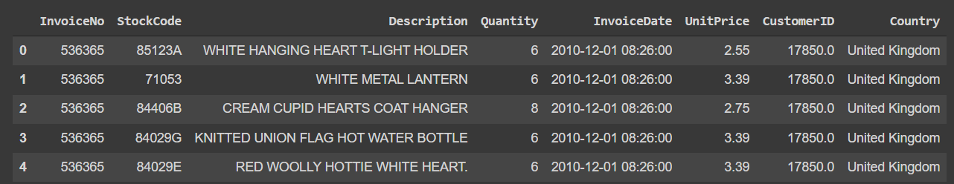
Importing Libraries & Data Inspection
Pandas – Manipulation of tabular data in Dataframes
Numpy – Mathematical operations on arrays
Matplotlib – Visualization
Seaborn – Visualization
Sklearn – Data Modeling
Original Dataset contains 8 columns and 541909 rows.

Slide 6
Data Cleaning
After dropping the duplicate values, now we have 8 columns and 536641 rows.
After dropping the null values, now we have 8 columns and 401604 rows.
We added 7 more columns to our dataset:
Amount_spent = df['Quantity'] * df['UnitPrice’]
Year = df['InvoiceDate'].dt.year
Month = df['InvoiceDate'].dt.month
Day = df['InvoiceDate'].dt.day
Hour = df['InvoiceDate'].dt.hour
Minutes = df['InvoiceDate'].dt.minute
Day_of_week = df['InvoiceDate'].dt.dayofweek

Slide 7
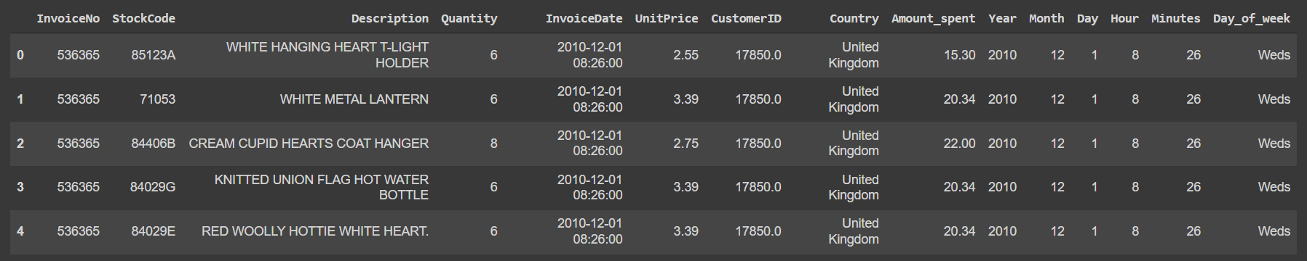
After cleaning and adding more column, we have the following data:

Slide 8
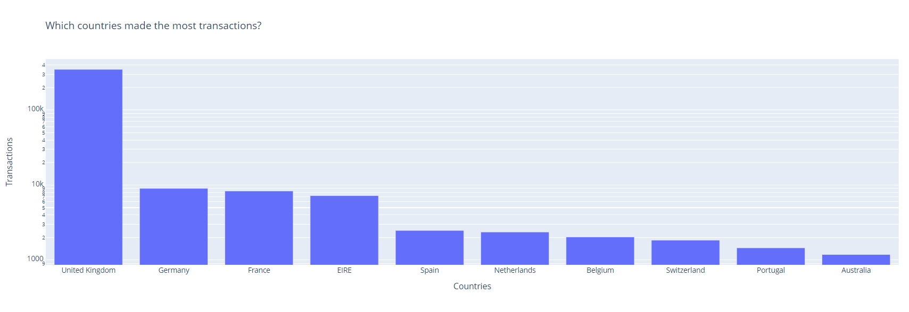
Exploratory Data Analysis
Which countries made the most transactions?
The above graph shows that which country have made the most transactions. United Kingdom have made most transactions followed by Germany.

Slide 9
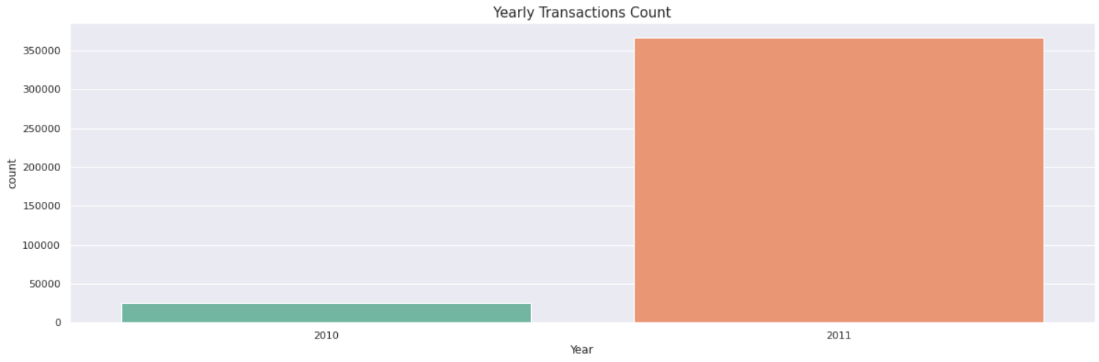
EDA Continued…
Yearly transactions Count

Slide 10
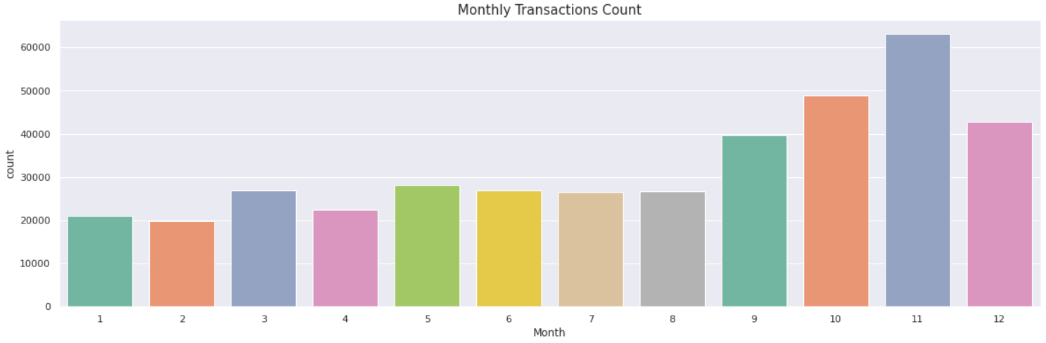
EDA Continued…
Monthly Transactions Count

Slide 11
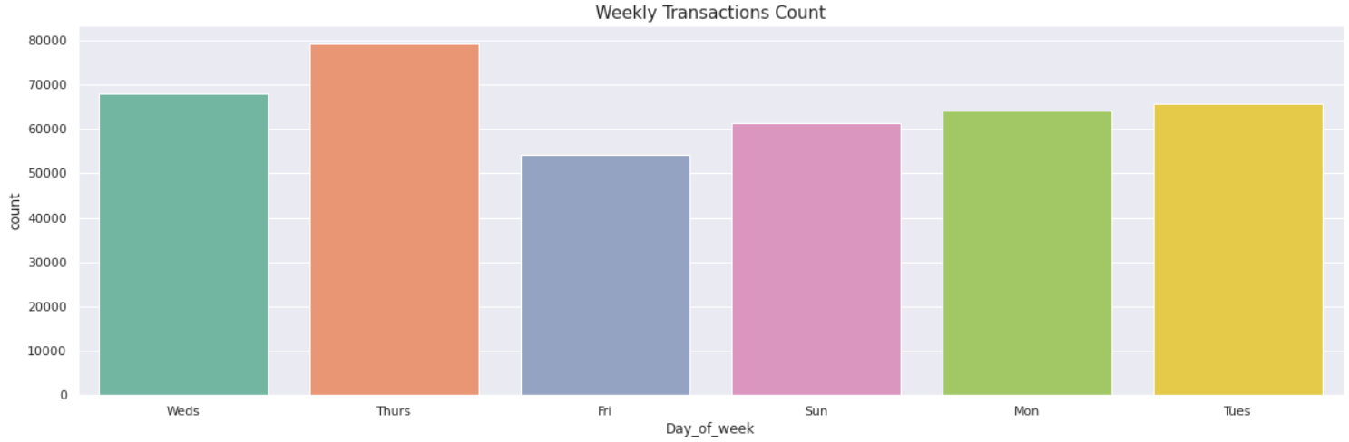
EDA Continued…
Weekly Transaction Count
.

Slide 12
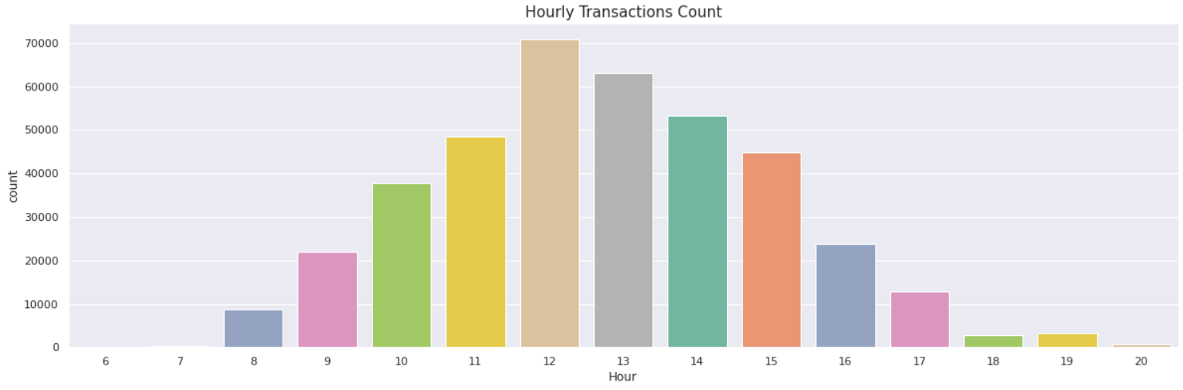
EDA Continued…
Hourly Transactions Count

Slide 13
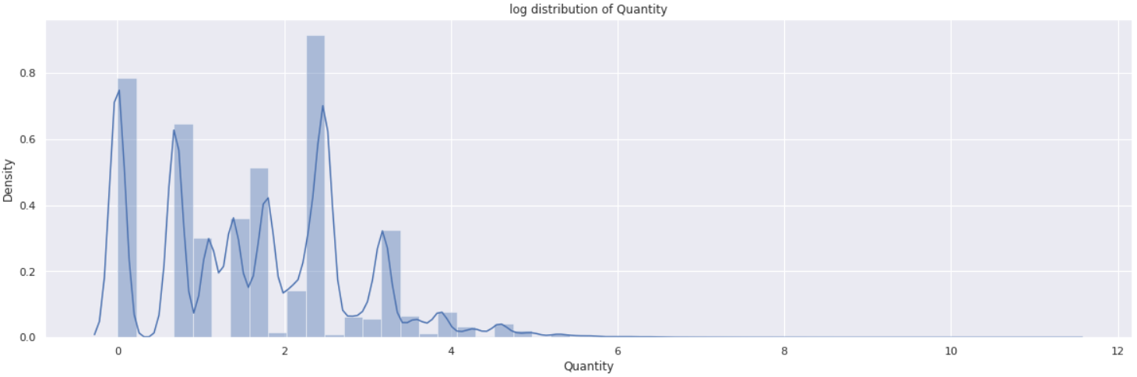
EDA Continued…
Log Distribution of Quantity

Slide 14
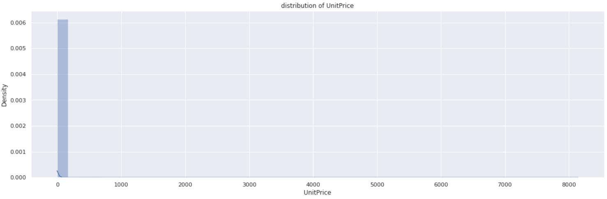
EDA Continued…
Distribution of UnitPrice

Slide 15
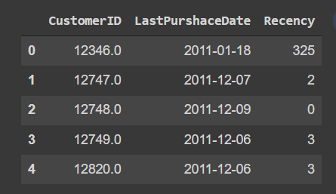
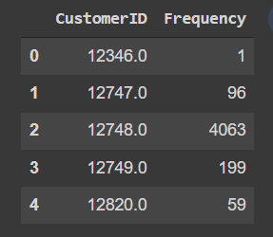
RFM(Recency Frequency Monetary) Analysis
RECENCY (R): Days since last purchase
FREQUENCY (F): Total number of purchases
MONETARY VALUE (M): Total money this customer spent.
Recency Frequency

Slide 16
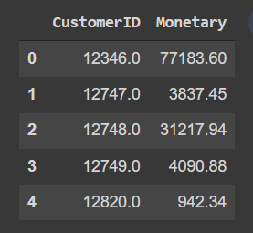
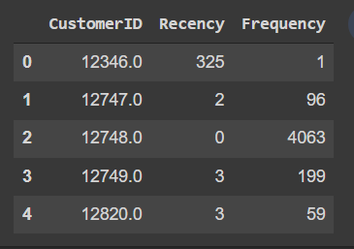
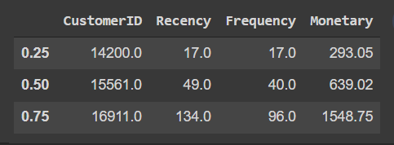
RFM Analysis Continued…
Monetary Recency with Frequency
RFM Quantiles(Recency, Frequency and Monetary)

Slide 17
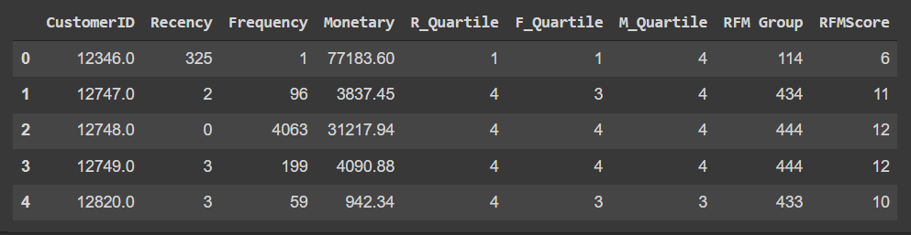
RFM Analysis Continued…
RFM Score
Best Recency Score = 4 (most recently purchase)
Best Frequency Score = 4 (most quantity purchase)
Best Monetary Score = 4 (spent the most)
Number of different types of customers:
Best Customers = 404
Loyal Customers = 961
Big Spenders = 966
Almost Lost = 96
Lost Customers = 18
Lost Cheap Customers = 337

Slide 18
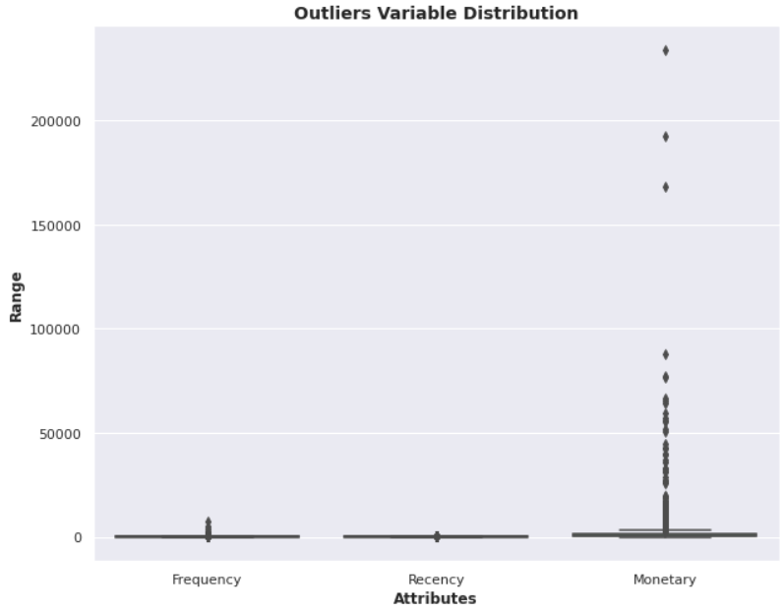
Model Preparation
Outliers Variable Distribution

Slide 19
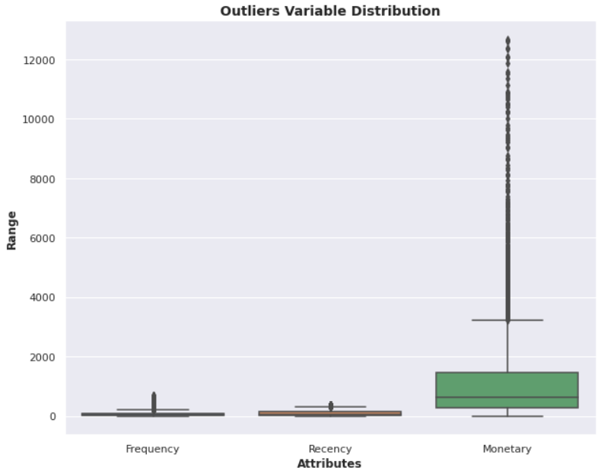
Model Preparation
Outliers Variable Distribution (After removing outliers for Amount)

Slide 20
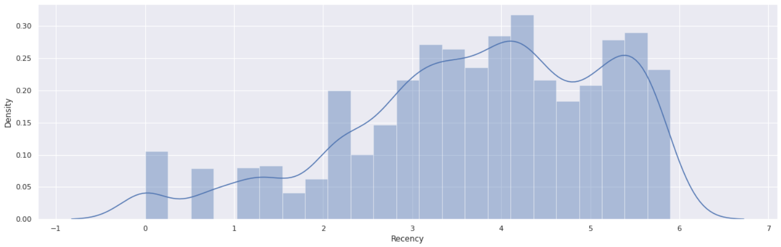
Model Preparation
Data distribution after data normalization for Recency

Slide 21
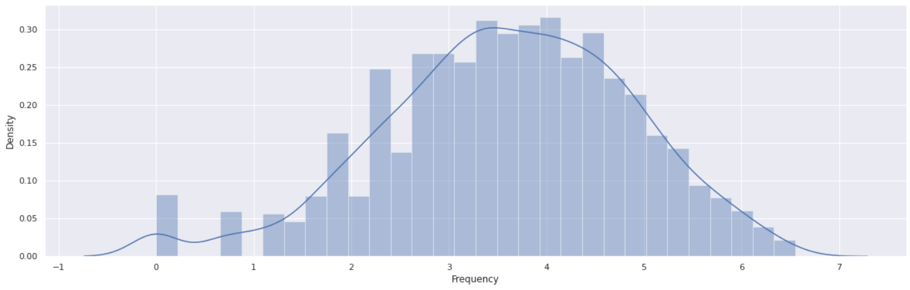
Model Preparation
Data distribution after data normalization for Frequency

Slide 22
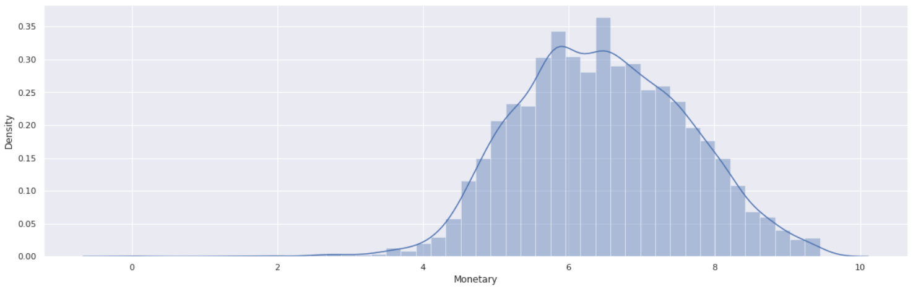
Model Preparation
Data distribution after data normalization for Monetary

Slide 23
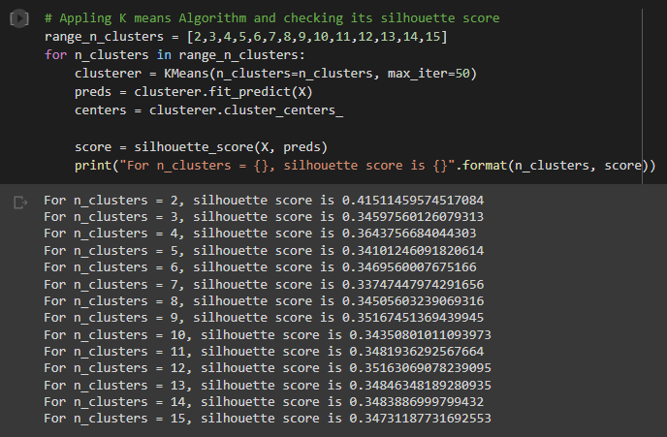
Data Modeling
Apply Silhouette Score Method on Recency and Monetary

Slide 24
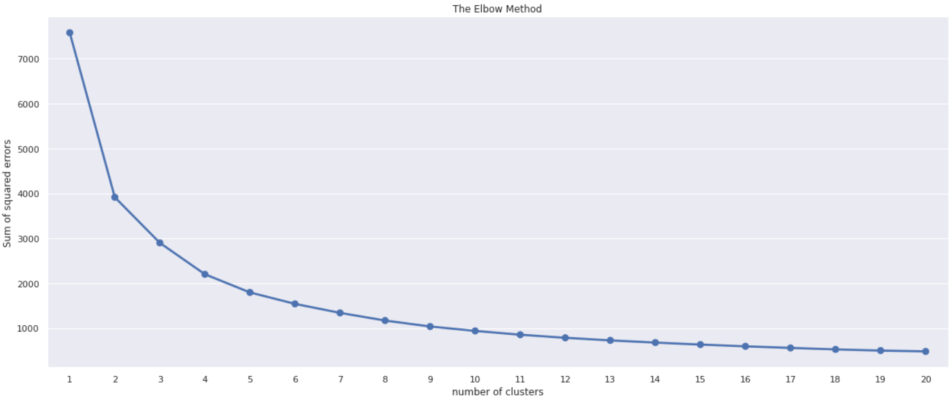
Data Modeling
Elbow Method on Recency and Monetary

Slide 25
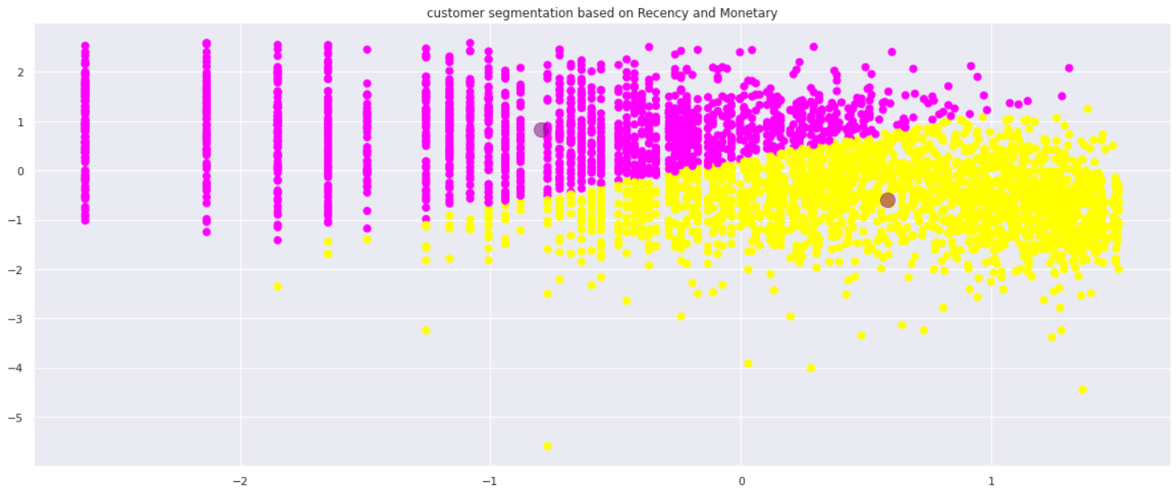
Data Modeling
Customer segmentation based on Recency and Monetary

Slide 26
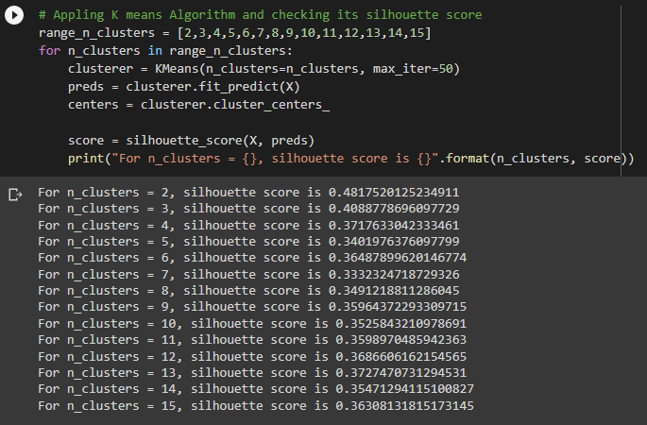
Data Modeling
Apply Silhouette Score Method on Frequency and Monetary

Slide 27
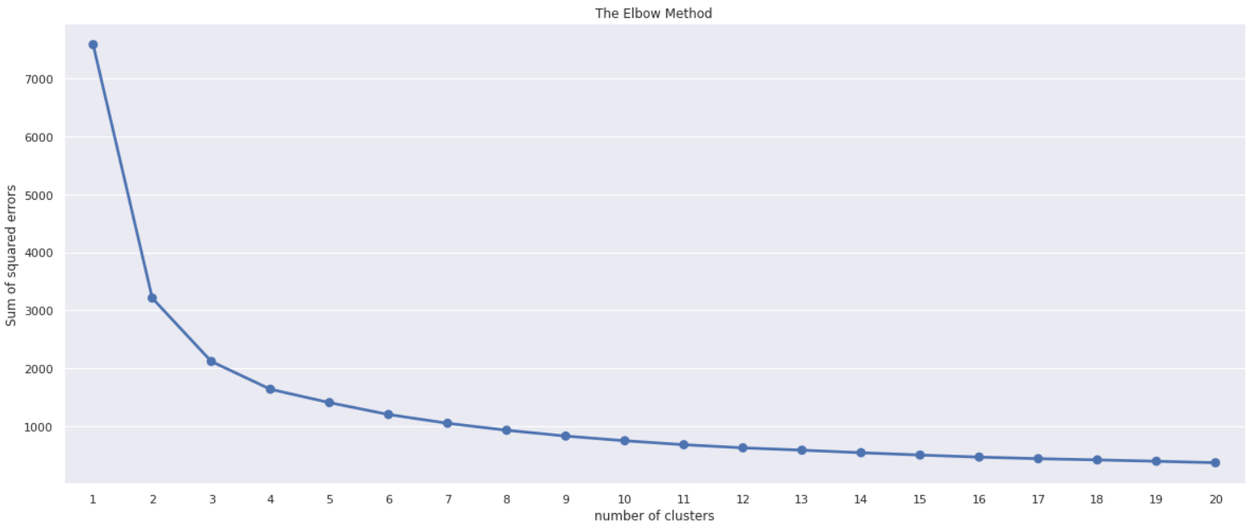
Data Modeling
Elbow method on Frequency and Monetary

Slide 28
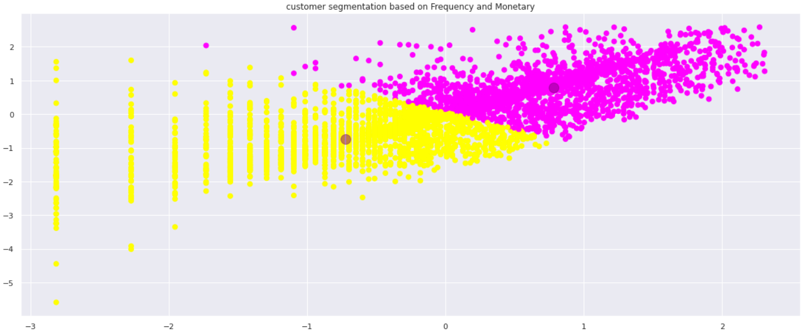
Data Modeling
Customer segmentation based on Frequency and Monetary

Slide 29
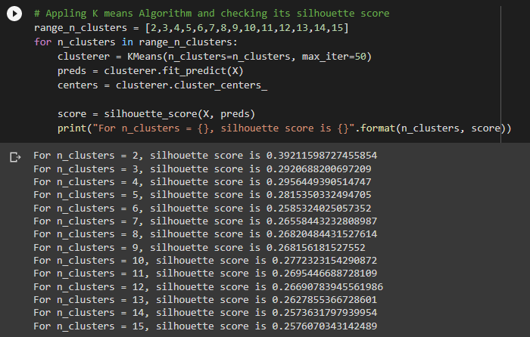
Data Modeling
Applying silhouette score method on Recency, Frequency and Monetary

Slide 30
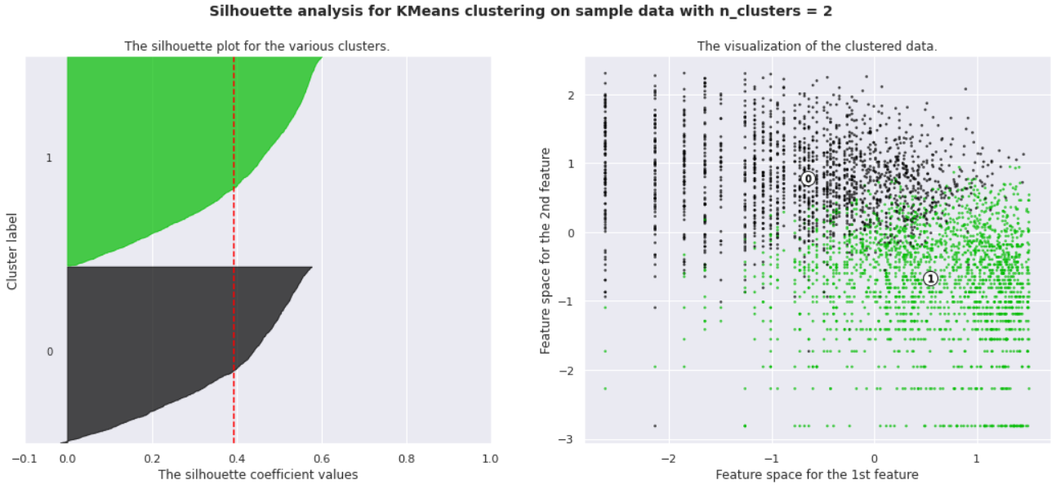
Data Modeling
Applying silhouette score method on Recency, Frequency and Monetary

Slide 31
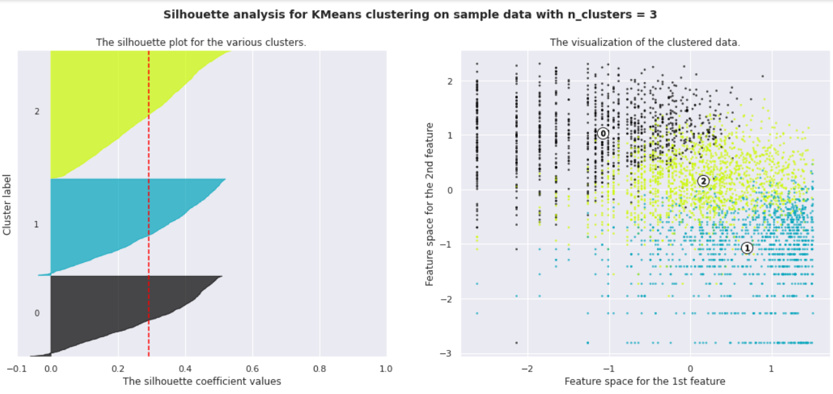
Data Modeling
Applying silhouette score method on Recency, Frequency and Monetary

Slide 32
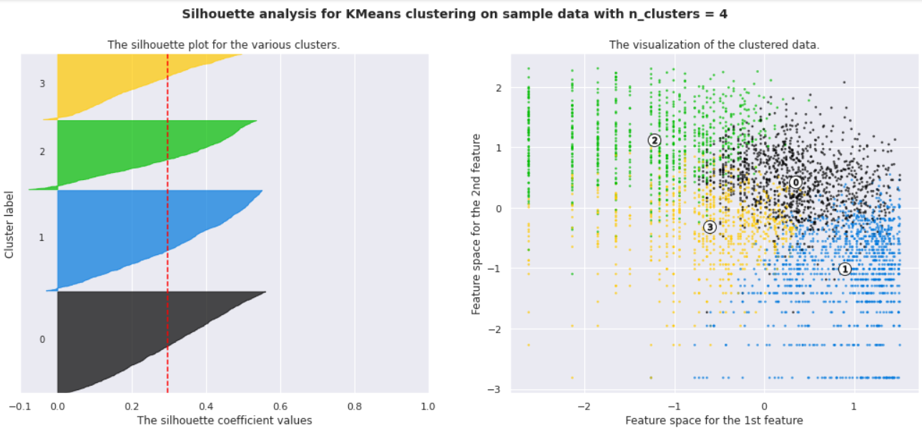
Data Modeling
Applying silhouette score method on Recency, Frequency and Monetary

Slide 33
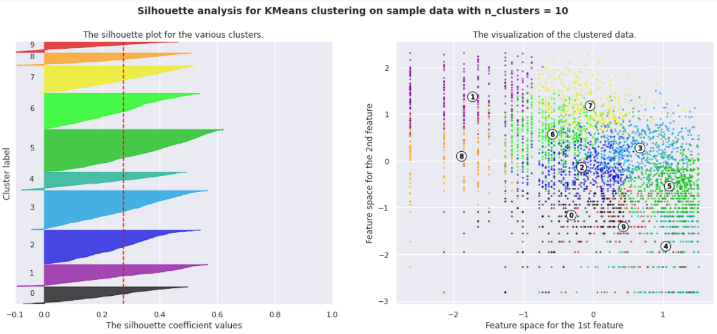
Data Modeling
Applying silhouette score method on Recency, Frequency and Monetary

Slide 34
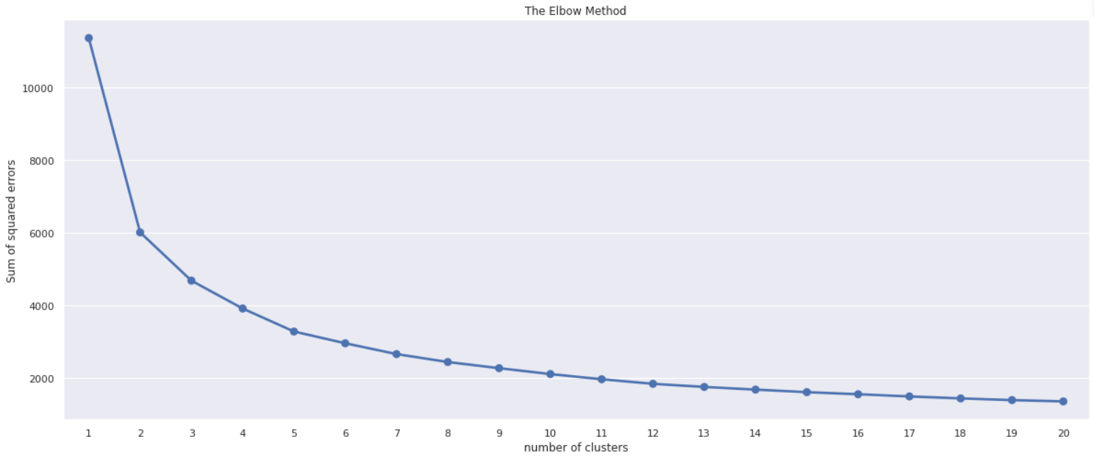
Data Modeling
Applying Elbow method on Recency, Frequency and Monetary

Slide 35
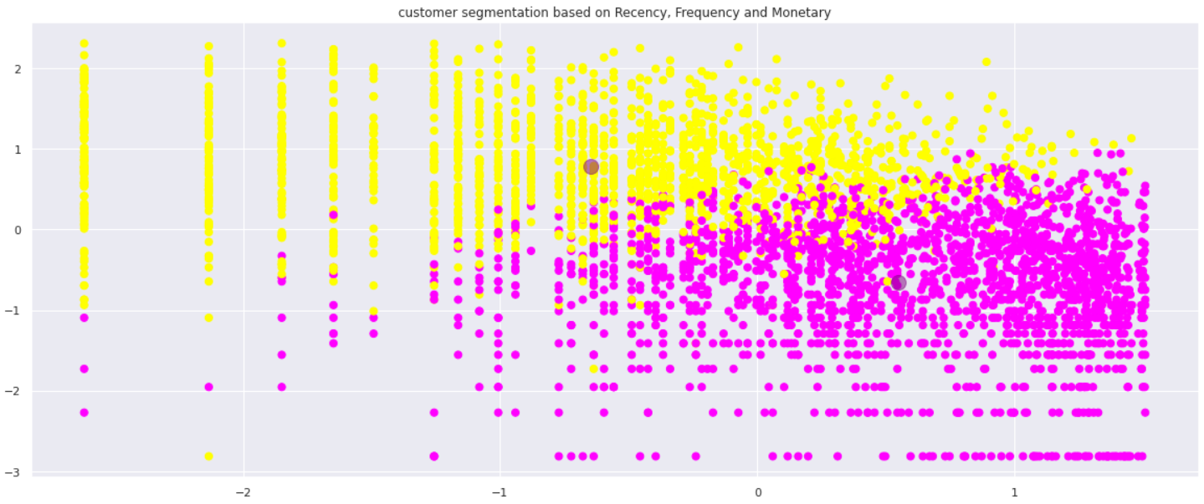
Data Modeling
Customer segmentation based on Recency, Frequency and Monetary

Slide 36
COUNT OF NUMBER OF CUSTOMERS IN EACH CLUSTER
CLUSTER 0 = 1735
CLUSTER 1 = 2055

Slide 37
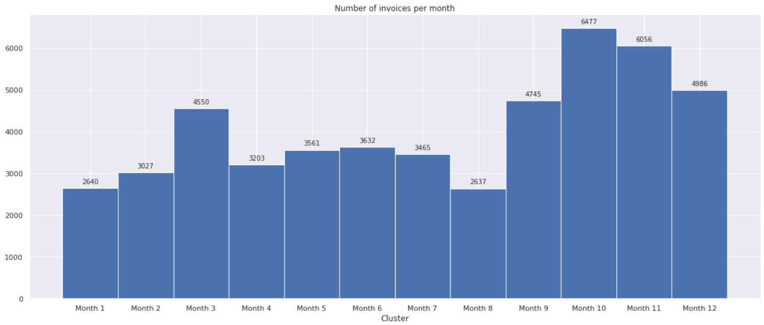
Cluster 0 Analysis
Number of invoices per month

Slide 38
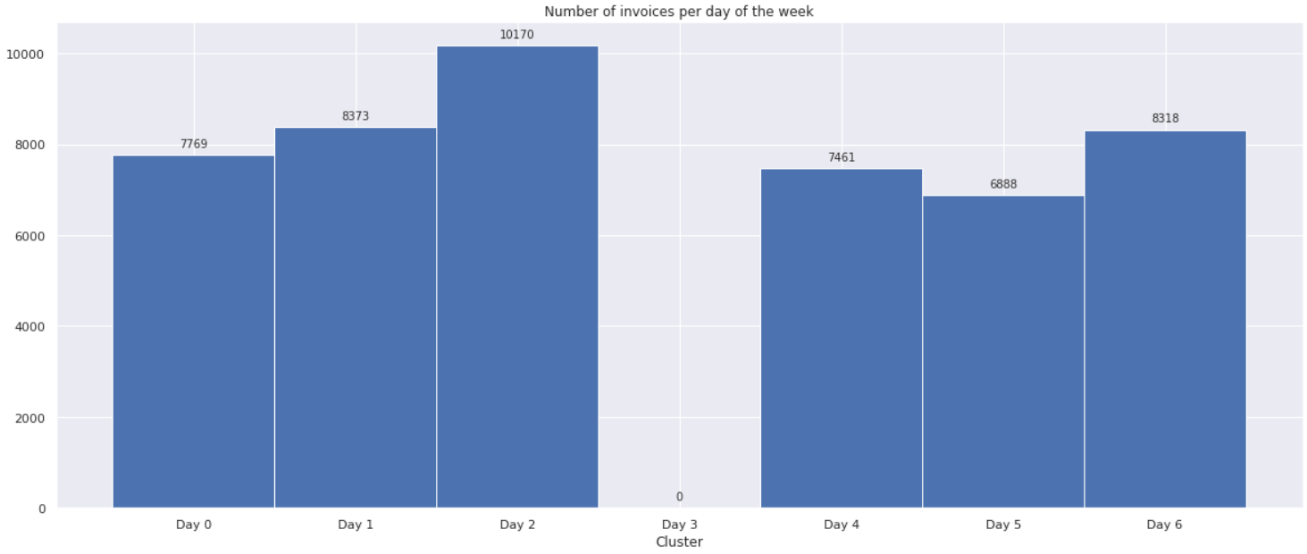
Cluster 0 Analysis
Number of invoices per day of the week

Slide 39
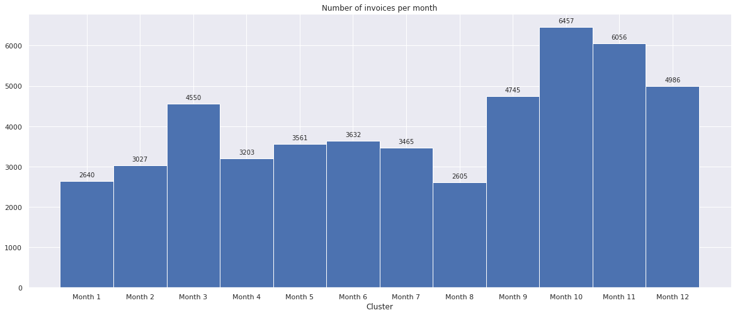
Cluster 1 Analysis
Number of invoices per month

Slide 40
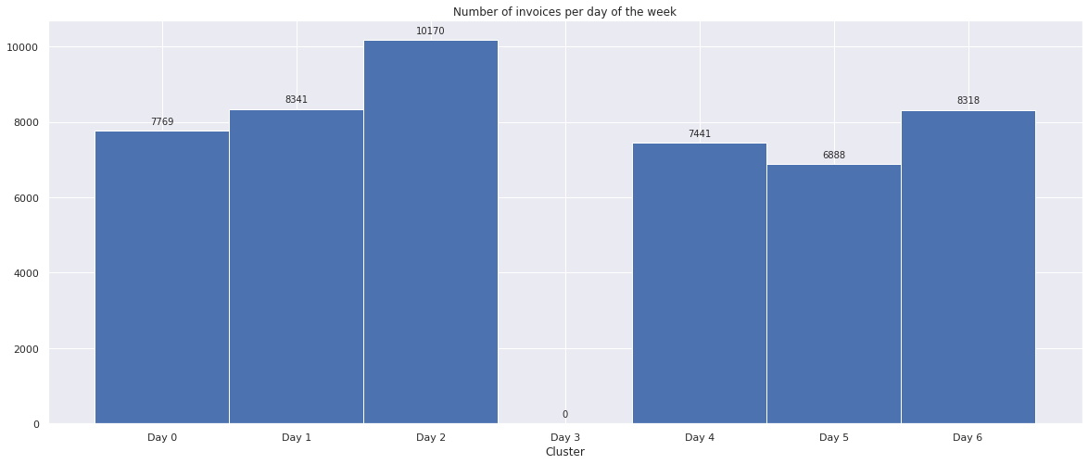
Cluster 1 Analysis
Number of invoices per day of the week

Slide 41
Conclusion
We have got 2 clusters by applying k means algorithm.
So the customers got segmented into 2 clusters.
Online Retail Customer marketing team can now use different approaches to acquire the customers.
Cluster 0
Key Figures
Frequency : 28.68
Recency : 230
Monetary : 3070
RFM Score : 10.71
Top 5 Products
WHITE HANGING HEART T-LIGHT HOLDER : 339
REGENCY CAKESTAND 3 TIER : 268
ASSORTED COLOUR BIRD ORNAMENT : 235
PARTY BUNTING : 229
REX CASH+CARRY JUMBO SHOPPER : 202

Slide 42
Conclusion
Cluster 1
Key Figures
Frequency : 37.67
Recency : 134.64
Monetary : 447.40
RFM Score : 5.90
Top 5 Products
WHITE HANGING HEART T-LIGHT HOLDER 344
REGENCY CAKESTAND 3 TIER 271
ASSORTED COLOUR BIRD ORNAMENT 239
PARTY BUNTING 232
REX CASH+CARRY JUMBO SHOPPER 204

Slide 43

Thank You!!

